Slide 1
National Standards of Healthcare Cleanliness 2019
Emma Brookes
Head of Soft FM Strategy & Operations
September 2019

Slide 2
Introduction and Overview
The environment in which we are working
The size and scale of the cleaning we do
Pilot
Overview of National Standards of Healthcare Cleanliness 2019
Questions

Slide 3
Current Environment
Fragile market
Continued pressure to find efficiency savings
Changing NHS landscape
Brexit
Variability in cost and quality of service
Trust resource constraints
Increasing activity

Slide 4
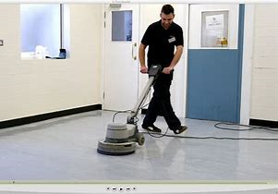
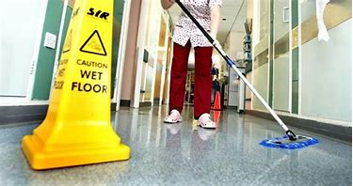
Size of the task
We clean an area the size of Gibraltar 3.5 times a week

Slide 5
Pilot
Pilot run from October 2018 – January 2019
30 trusts took part across England & Wales
Comprehensive data received from 21 trusts
Amendments to document taken place from comments
received
Highlight changes – Changes to document to reflect the pilots and the working group meeting, in particular audit and risk categories

Slide 6
Risk Categories
Current 4 categories: Very high risk, high risk, significant and low
Proposed change: 6 categories
Functional risk category | Audit target score | Audit frequency*
FR1 | 98% and above | Weekly
FR2 | 95% and above | Monthly
FR3 | 90% and above | Every two months
FR4 | 85% and above | Every three months
FR5 | 80% and above | Every six months
FR6 | 75% and above | Every twelve months

Slide 7
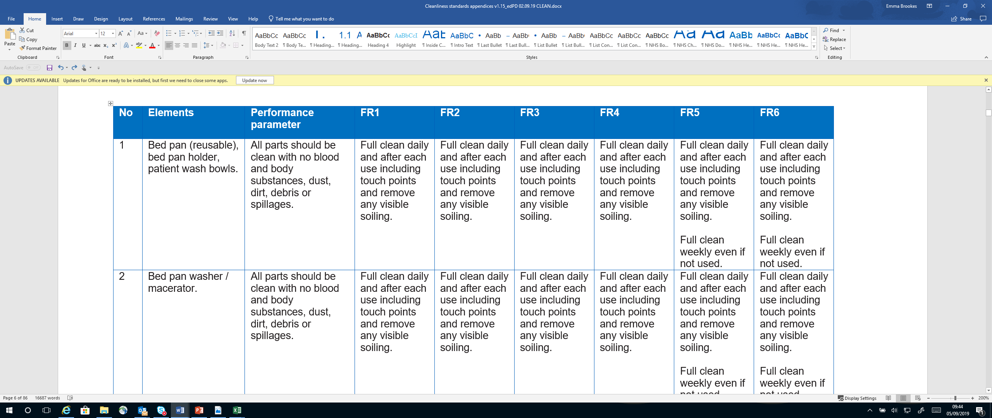
Elements
Current elements: 49
Proposed elements: 50

Slide 8
Cleaning Responsibilities Framework
Addition of suggested responsibilities
Organisation columns
Compliance will be in having and regularly reviewing with an MDT

Slide 9
Functional Areas & Risk Categories
Suggested areas risk ratings updated
List comprehensive but not exhaustive

Slide 10
Stages of Audit
Current:
Technical audit that checks and scores visual cleanliness
Managerial audit that checks and scores visual cleanliness
External audit to provide quality assurance
Proposed:
Technical audit that checks and scores cleanliness outcomes against the safe standard
Efficacy audit that checks the cleaning team at the point of service delivery to validate the efficacy of the cleaning process, i.e. the correct use of colour coding, equipment, materials, methodology etc., as well as supporting policies and procedures.
External audit to provide quality assurance and to check both the technical audit and the efficacy audit.

Slide 11
Technical Audit
No change to paper audit
Work with audit software suppliers
Audit of blended areas
Link to star ratings
Improvement plans
Escalation of rectifications

Slide 12
Efficacy Audit
Designed to check processes
Provides assurance

Slide 13
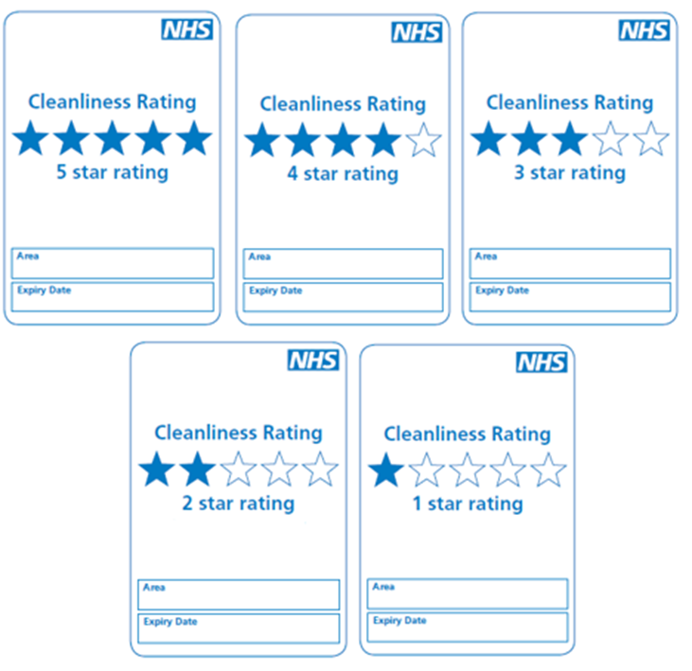
Star Ratings
Replace the current percentage displayed
To be displayed in all patient facing areas

Slide 14
Star Ratings Escalation Process

Slide 15
Commitment to Cleanliness
Standard document for display in all organisations
Frequencies and responsibilities clearly displayed

Slide 16
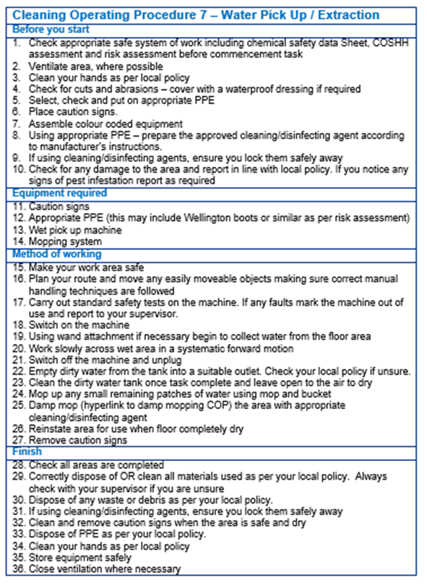
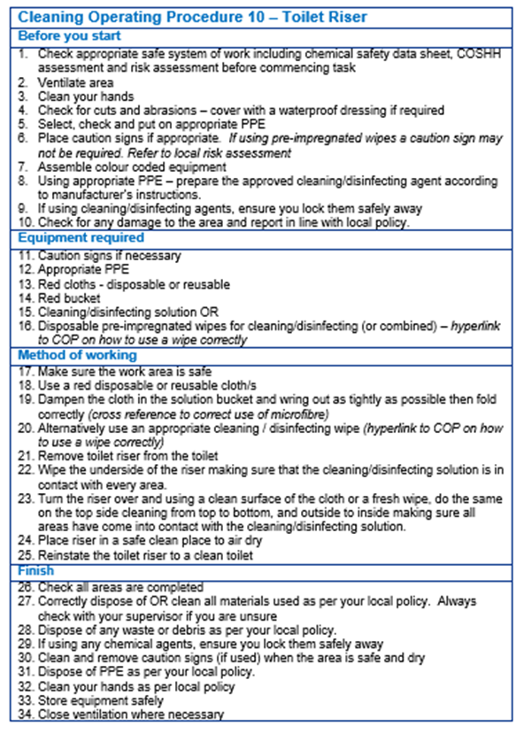
Cleaning Operating Procedures

Slide 17
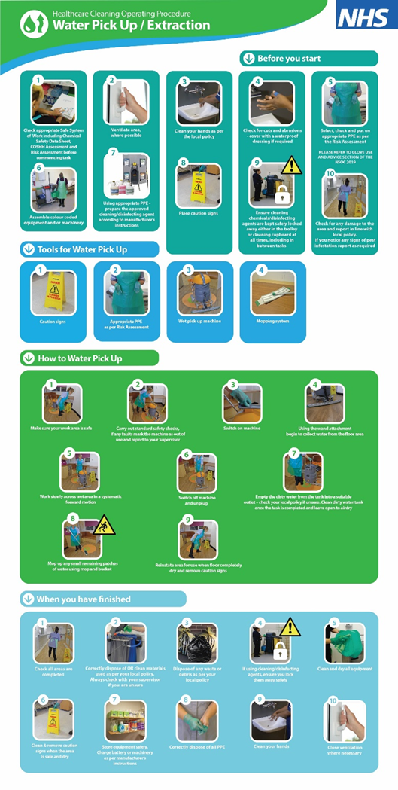
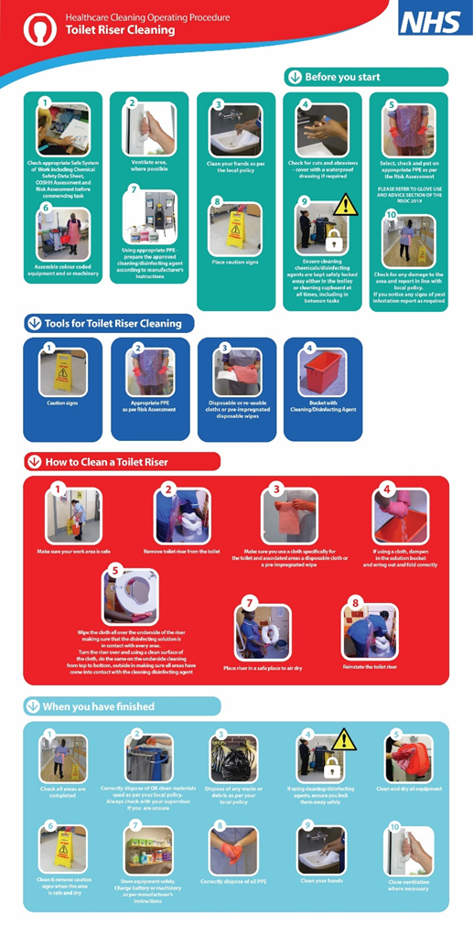
Cleaning Operating Procedures

Slide 18
Questions?
CONTACT:
Emma.brookes4@nhs.net

