Slide 1
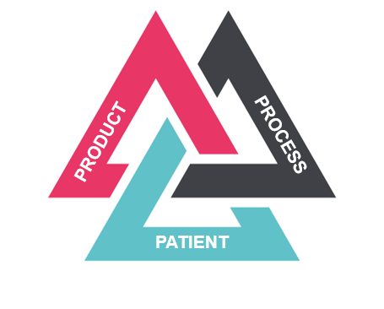


Value Based Healthcare and Procuring on Outcomes
ACHP- Professional Development Programme 12th September 2019
James Griffiths
Senior Project Manager Value Based Procurement
NHS Wales Shared Services Partnership - Procurement Services
Email: james.griffiths@wales.nhs.uk
Tel: 01495 765120

Slide 2
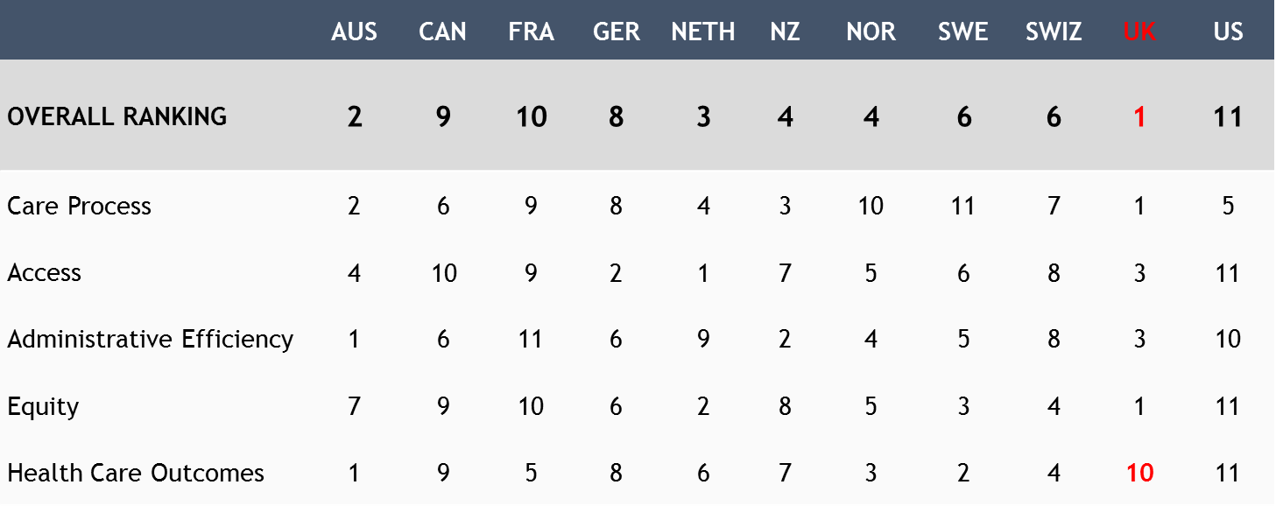
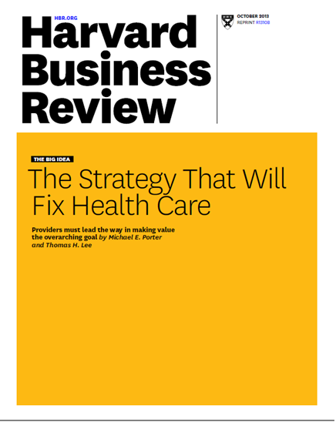


Value Based Healthcare in NHS Wales
The Case for Change
© Value 4 Wales, NHS Wales

Slide 3
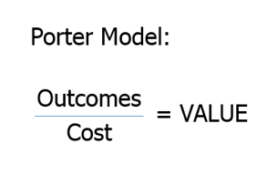
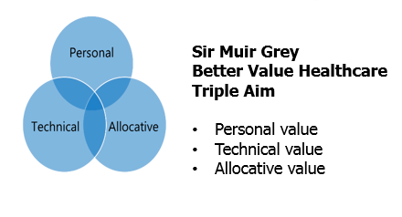

Value-Based Health 2 models become 1
© Value 4 Wales, NHS Wales
NHS Wales predicated its definition of Value on MP by improving health outcomes for the same/lower costs; combined with MG ensuring ‘allocative value’, where practicable resources are shifted across the organisation, seeking to apportion resources where it has greatest impact, resulting in a replicable and sustainable model

Slide 4
‘Value-Based Health Care - an enabler’
Achieving best possible outcomes for people
= Value in Health care
Utilising our resources appropriately

Slide 5

ABUHB Approach - Vision and Aim
Vision - Improve the experiences, achieve the outcomes that matter to people, whilst being good stewards of the finite resources available and working together to do the right thing across the whole system
Aim - To systematically collect patient reported experience and outcomes to provide data driven evidence that can be used to determine the clinical and cost-effectiveness of treatments and services in order to meet the overall aims of ‘A Healthier Wales’ and ‘Clinical Futures Strategy’.
Copyright © ABUHB, VBHC Programme

Slide 6
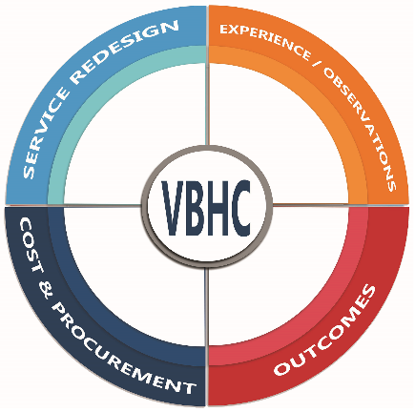
ABUHB Approach - Component Parts
Patient and Family | Carer Experience | Observations
Real World Outcome Collection | Measurement of Patient and Family | Carer reported outcomes (Risk adjusted)
Costing - Various methods PLCs and TDABC
Procurement | Commissioning - Putting outcomes at the heart of the decision making process
Remodel services - A patient centred approach using the data as evidence to drive decisions
Copyright © ABUHB, VBHC Programme

Slide 7
Our Programme - Outcomes & Cost effectiveness
Colorectal Cancer
Pulmonary Rehabilitation
Heart Failure
Urinary Flow
Pleural Disease
Inflammatory Bowel Disease
Diabetes
Parkinson’s
Lung Cancer
Dementia
Alcohol
Liaison
Service
Epilepsy
Myeloma
Haematological
Cancers
CWMS
AWMS
Critical Care
Stroke
Lymphoedema
Foot & Ankle
Orthopaedics
Sleep Services
Cataracts
Ankylosing Spondylitis
Copyright © ABUHB, VBHC Programme
Psoriasis
Eczema

Slide 8
ABUHB Approach - Performance
Live across 150 + outpatient clinics across all hospital sites
PROMs issued 26,032 | PROMs completed 19,911 (76.5%)
Remote collection rate (62.3%)
> 100 + clinical and health care professionals involved in programme
Copyright © ABUHB, VBHC Programme

Slide 9
‘The Foundations - it takes time’
Outcome collection is not new
Historically no SYSTEMATIC collection of outcomes - Patient reported!
2015 - Aneurin Bevan University Health Board - Programme
- c 20 condition areas - data driven evidence - remodeling opportunities
2018 - Scaled up Nationally
Looking to collect and combine across 15 common areas over next 3 years
Started to produce data dashboards to enable benchmarking at a system level
2019 - Working in partnership with (NWIS) National Welsh Informatics Service and (FDU) Finance Delivery unit
Developing information products to support decision-making across NHS Wales

Slide 10
ABUHB Approach - Journey
2015-16 DISCOVERY Create a culture, language and behaviour towards VBHC
2016-17 PREPARATION Intention | Started to change
2017-18 ACTION Practice and grow
2018-2019
SCALE & ALIGN
to priorities against IMTP | C Futures
2019-20 SO WHAT - Understand impact and benefits realised
2014-15 IDEA formed
Copyright © ABUHB, VBHC Programme

Slide 11
‘Measuring Outcomes - Why?’
For use in direct care - to aid the consultation between patient and clinician, focus on what matters to the patient today!
Informing the decision making process - is surgery the best option?
Help clinicians understand their practice - compare with colleagues
Provide data to enable service development - re-modelling
Enable World-wide benchmarking
Outcomes to be used at the heart of Contracting & Commissioning

Slide 12
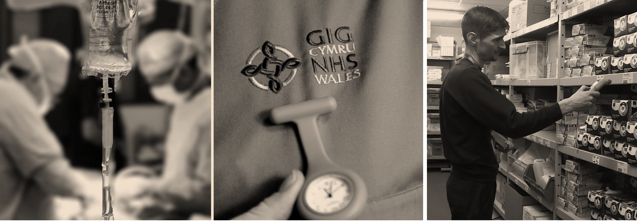

Vision Statement
Delivering Value for Wales
placing outcomes at the heart of Procurement
Assessing the value and measuring what matters, using outcome divided by cost and placing clinical and patient reported outcomes at the heart of the procurement decision making process.

Slide 13
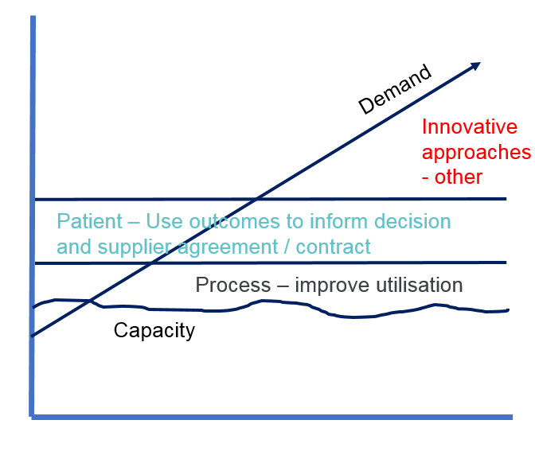
Why this approach now?
Strong pressure to reduce direct expenditure
A price only approach to many areas of expenditure
Lack of consideration by Procurement on quality of care or longer term economic implications
System suffers from a lack of incentives, tools and expertise to consider the complete value - products and services can offer at different levels across health and social care
Adding VALUE, utilizing TECHNOLOGY, COLLABORATING with Industry to INNOVATE and ADAPT to improve health outcomes and efficiency is widely acknowledged
Moving to a Value Based approach ……

Slide 14




Value Based Procurement
Payment made when satisfied with outcome
Goods/drugs typically paid for up front

Slide 15



Value Based Procurement - Why?
…but a disconnect from outcomes that matter to the patient!
Great effort and resource
Procurement tasked with product price reduction.
Encouraged to look at innovation to improve process efficiency without being sure of efficacy.
Ambition - World leading with the ability to compare outcomes

Slide 16
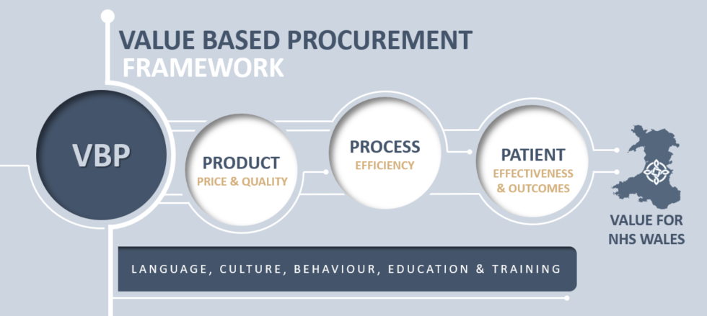
Value Based Procurement Framework
Product: Quality driven standardisation Once for Wales,
Process: Measuring care across all pathways
Patient: Putting the PATIENT at the centre, using both patient and clinical outcomes to drive procurement decisions

Slide 17
Value Based Procurement - What?
PATIENT
Ultimate goal - putting the PATIENT at the centre, using patient and clinical outcomes to inform the requirement, and good measurement to evidence improved outcomes. Broader socioeconomic considerations
PROCESS
Greater transparency and assessment of cost beyond product. Focus on leaner processes, avoid unnecessary cost, increase efficiency, TDABC/PLICS
PRODUCT
Best price above quality threshold.
Well proven and still appropriate,
based primarily on up-front
purchase costs.
Value
If value increases the closer we get to the patient ,and the range of benefits increases we should broaden the scope of our procurement focus.
Socio-economic
Socio-economic
Patient
Product Process
Patient
Outcomes

Slide 18



Pilot Project - Enhanced Recovery After Surgery (ERAS)
Sharing financial benefits and risks of process improvement linked to length of stay
Supplier to implement ERAS, standardising pathway reducing LoS
VBP Key Features
PROCESS
Partnering with supplier to share the risk
Contract details KPIs
Payment linked to targeted reduction in LOS
Any “saving” derived shared between supplier and UHB once LOS reduction evidenced
Impact for both NHS and supplier if targets not met.
Pilot location
Aneurin Bevan UHB in 2 hospitals
Colorectal Department
Elective surgery
Description
Expected Results
Incremental investment from UHB
Annual review of progress versus LOS target
Agreed share of savings split as per contract between supplier and UHB
Potential penalties for missed targets and increased re-admissions
At an estimated cost of £200 per bed day across several hundred patients per year “saving” >£200k per annum (net of incremental investment)
Better use of resources
Increased capacity for patient care

Slide 19


Pilot Project - Faecal Incontinence (FI) Sacral Nerve Stimulation
Recommended by NICE as a cost-effective use of healthcare resources
PATIENT
Minimally invasive implant designed to reduce episodes of severe faecal incontinence
VBP Key Features
Patient baseline FI episodes and QoL measured before implant
Clinical/Supplier and Procurement agreed minimum improvement in reduced episodes and increased QoL
Evidence of improvement triggers payment 12 months after implant
Zero payment if minimum improvement not evidenced
Pilot location:
Cardiff and Vale UHB (Business case pending)
Colorectal Department
Elective surgery
Description
Expected Results
Piloted with 10 patients in Cardiff
Episodes of FI reduced by at least 50% - 70%
Positive impact on QoL and socio-economic benefits
Reduction in need for ongoing conservative management in the community
Potential to help avoid more invasive and life changing stoma surgery
More streamlined and co-ordinated pathway
SNS for those suffering with severe FI
FI effects both men and women but greatest cause is obstetric injury
Device reduces frequency of FI by min 50-70% sometimes more
Potential to help avoid more invasive and life changing stoma surgery
Significant reduction in FI can significantly improve patient QoL and wider socio-economic benefits
Available in England not currently commissioned in Wales

Slide 20



Idea – Antimicrobial sutures
Some early adopters | ideas ….. Financial models
Pilot potential - Evidence of potential to reduce the incidence surgical site infections (SSIs) when antimicrobial sutures are used in conjunction with supporting standardised pre and post op procedures
Assumptions - Savings can be realised by reducing infection rates that will lead to quicker post operation recovery time, reduce the need for unnecessary intervention and reduce patient LoS – making better use of scarce resources.
Studies suggest potential to reduce incidence by 30% and current estimates of the cost of an SSI are >£3000 per patient. The cost of the antimicrobial sutures are 25-30% higher than standard but potential value is significantly higher.
Is there an opportunity to partner with suppliers and clinicians to gather further evidence of the wider benefits and value and to develop as risk sharing VBP approach?

Slide 21

From Process to Patient, laying the foundations…
NHS Wales – currently in a formal competitive dialogue to re-contract on an All Wales basis for a new service model for the supply medical appliances that are currently dispensed on prescription.
Value Based Approach – Through dialogue we are working with suppliers to remodel the approach to remove any unwarranted variation across secondary and primary care and ensure that any efficiency savings can be re-invested into the service.
The contract period has been extended to allow for supplier partnership and the development of capabilities that should allow:
process and efficiency savings with supporting evidence
the possibility to link product choice to patient outcomes
the ability to collect CROMS/PROMS – putting the patient at the heart of the decision making process.

Slide 22
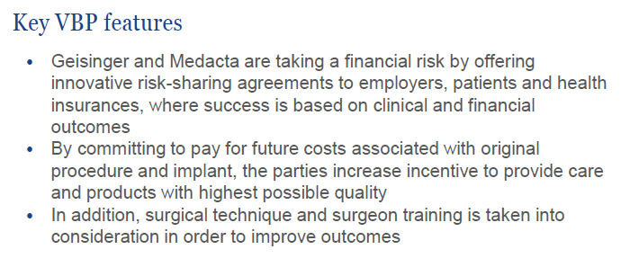

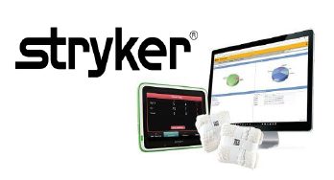
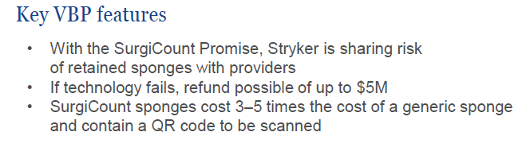

The VBP momentum is building…

Slide 23
Value Based Procurement - Who?
ENABLERS
Finance. The power / strength to allocate resource, influence and make decisions
Suppliers. Experts, specialists. Long-term partnership
Procurement. Power of negotiation. Relationship management
Outcomes collection. Vision and insight
Successful OBP
Clinicians. Convinced of the benefit. Driving change in care.
I.T. Engagement from the beginning. Key enablers.
Patients. Central to outcome collection. Our raison d’etre!

Slide 24

We need to progress….
Challenge to industry and NHS is to:
Move beyond 1st P or PRODUCT (where appropriate)
Increase the frequency and depth of engagement around the 2nd P of PROCESS
Advance to the 3rd P or PATIENT where reported OUTCOMES inform decision making and payment.
If we are not yet in a position to contract and share risk based on patient outcomes we can still work together and decide how best to advance in this direction.
Be prepared to be challenged on your evidence of true value.
THANK YOU FOR LISTENING!

